Slide 1
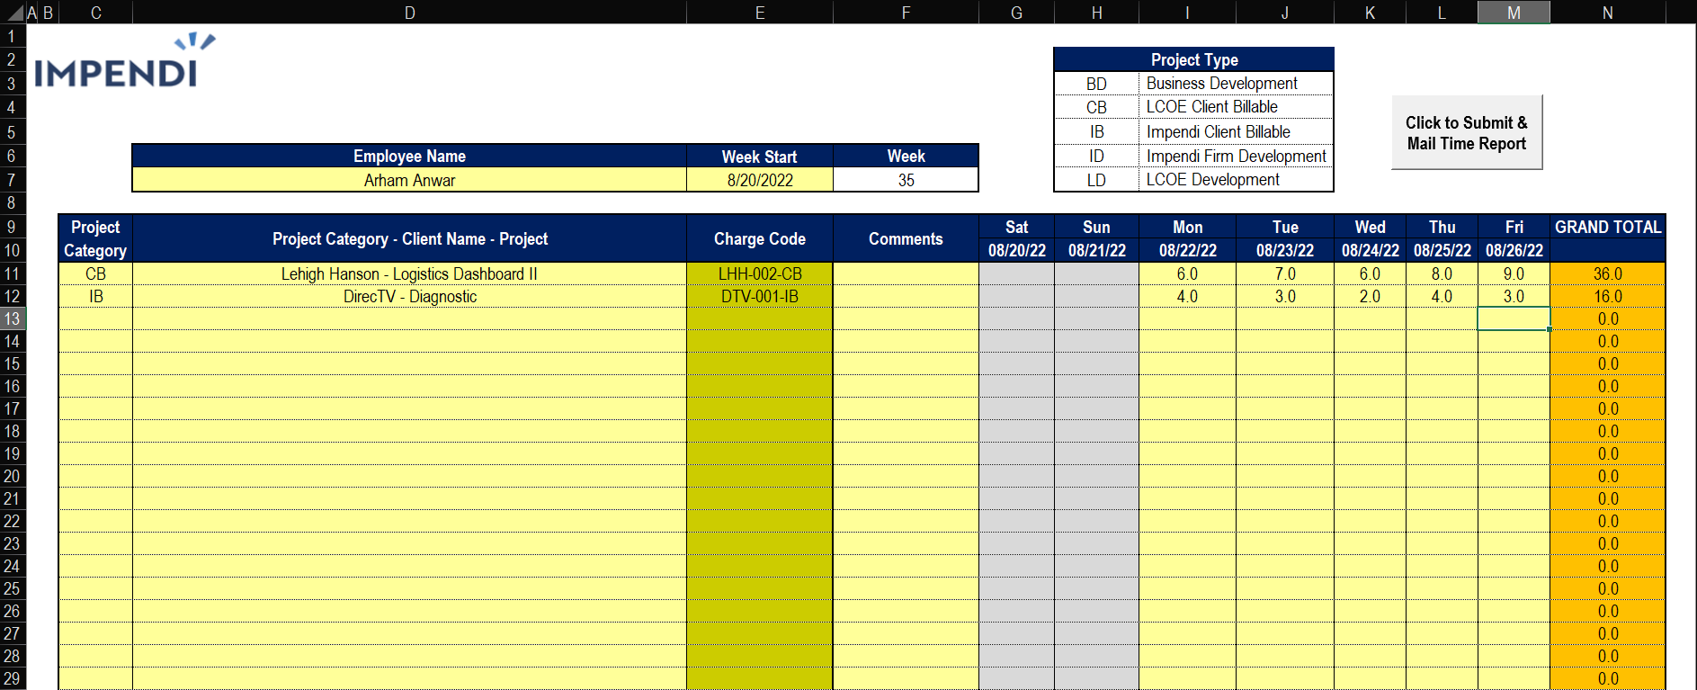
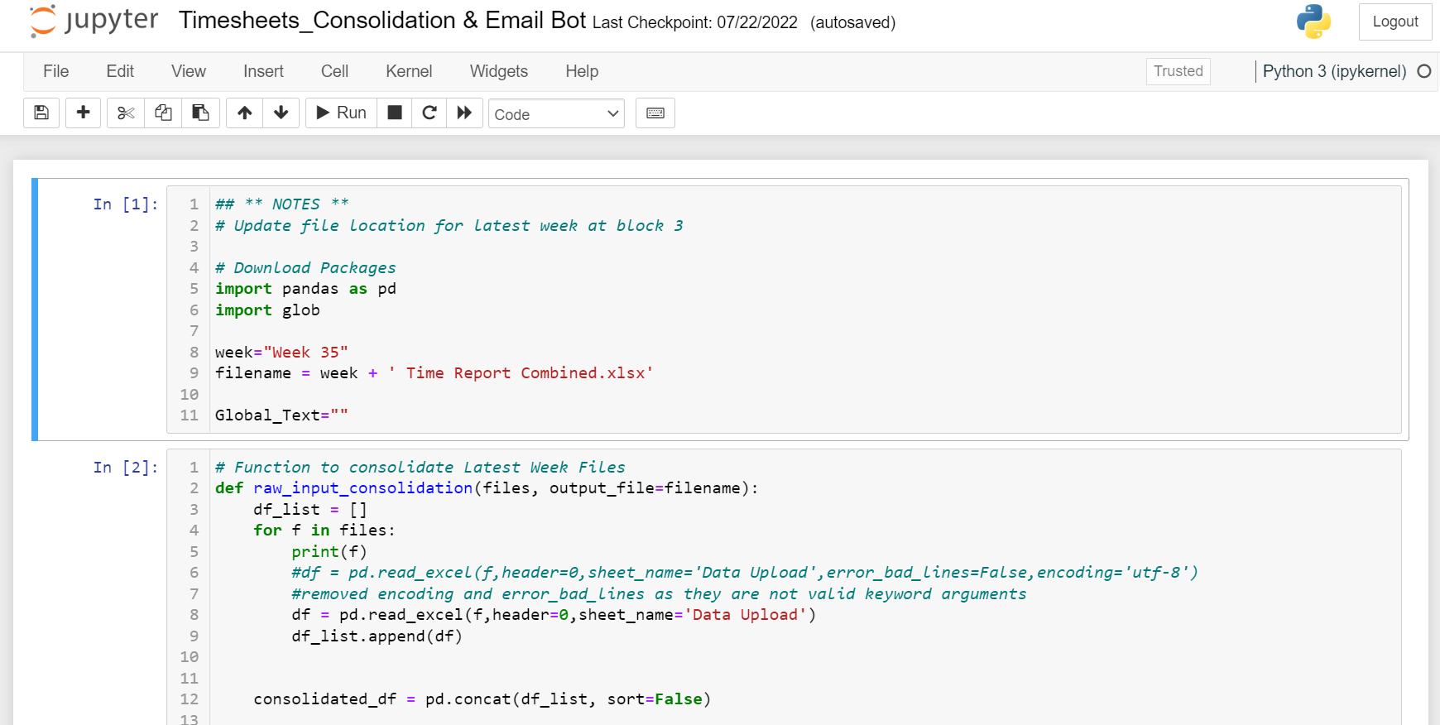
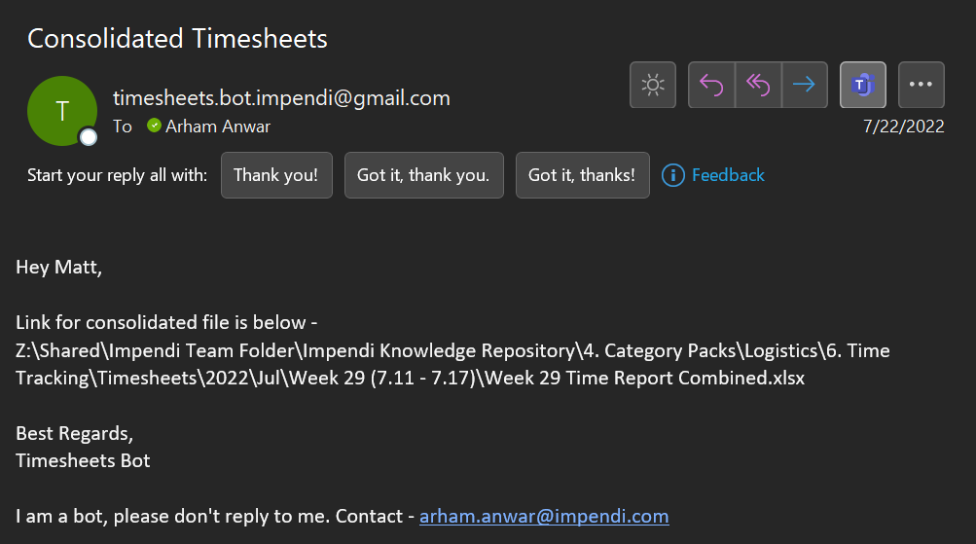
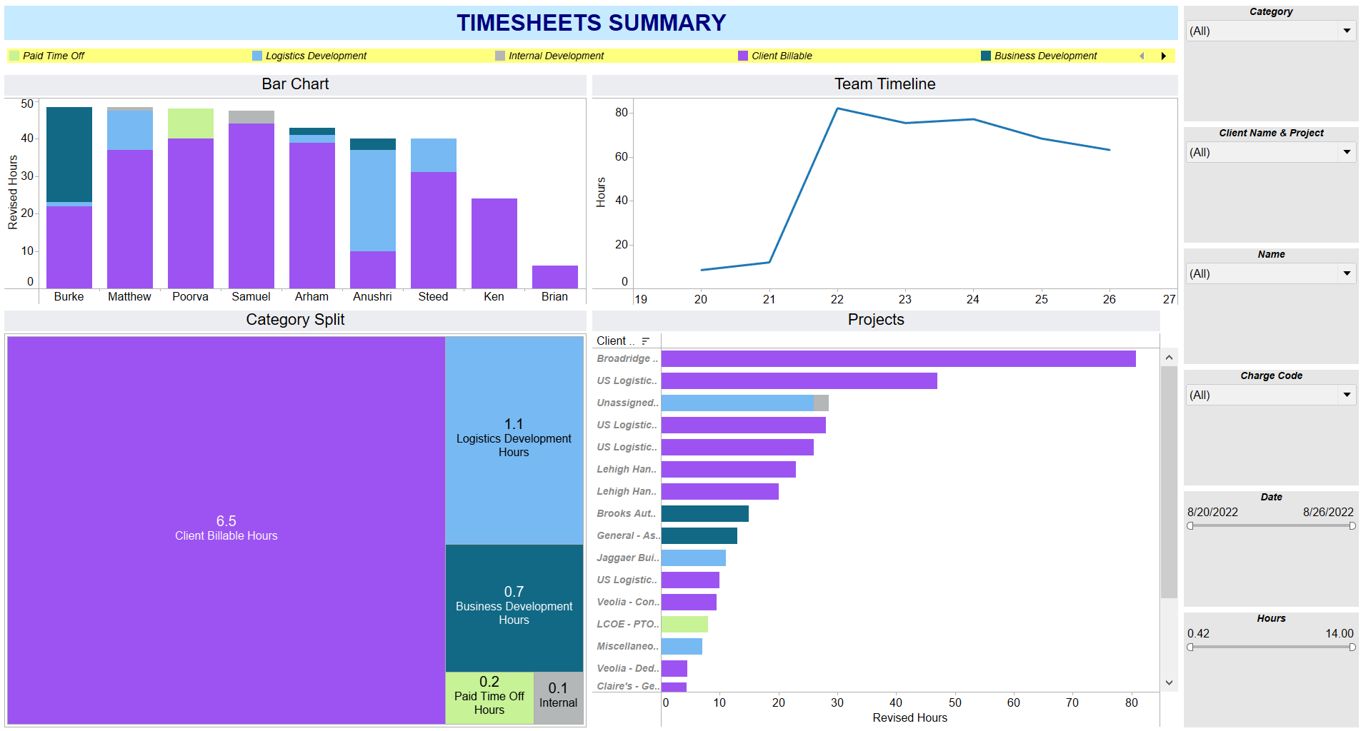
Team fills macro enabled weekly timesheets on drive, which get sent to timesheets bot via email upon saving the file
Timesheets Bot
Reads the files from drive, Cleans data , Consolidates the files and Emails the file to respective team managers
Dashboards and Consolidated files are sent to project managers via email through the bot
Consolidated File is automatically plugged into the dashboard

